Slide 1
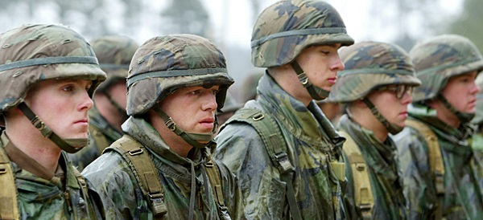
The Veterans’ Healthy Minds Advisory Council – South Texas
(VHMACST)
The mission of the independent Council is to establish a true partnership between the Veterans and their families, VA Healthy Minds professionals, Community Partners and Veteran Service Organizations (VSO) in order to improve the quality of Mental Health Services, to improve Veteran and family understanding of those services, and promote best use of those services.

Slide 2
What is the Veterans’ Healthy Minds Advisory Council – South Texas
(VHMACST)?
The Veterans’ Healthy Minds Advisory Council – South Texas (VHMACST) is a group of Veteran healthy mind consumers and their family members.
  Consumer: a Veteran who has received or who is receiving mental health or substance use services
  May also include representatives from community mental health agencies
    Ex: NAMI (National Alliance on Mental Illness), Depression and Bipolar Support Alliance, Veteran Service Organizations, and local community employment and housing groups
The council is independent of the VA, but partnership is the goal.
  Current VA employees cannot be members
Staff Liaison: coordinates the work of the council and its communication with the leadership of the facility’s mental health programs

Slide 3

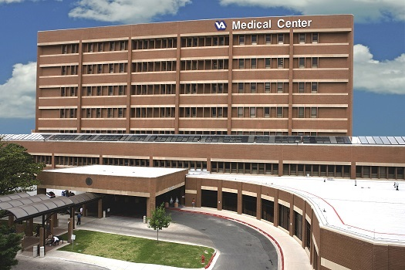

What are the functions of the VHMACST?
Educate Veterans, family members, VA Staff and the community on issues and resources surrounding veteran mental health issues
Reduce barriers to accessing mental health services for Veteran’s and families, including stigma, lack of information about services, and difficulty navigating the VA System
Provide Veteran and other stakeholder (e.g., family members, caregiver, VSO’s, community partners) input into the VA mental health services
Advocate for Veterans (collectively) to the extent that is appropriate and pertinent to healthy mind issues
Veterans’ Healthy Minds
Advisory Council – South Texas
Veteran Community
South Texas Veterans Health Care System

Slide 4
Why is VHMACST important?
The Handbook on Uniform Mental Health Services in VA Medical Centers and Clinics mandates that all VA mental health services be “recovery-oriented.”
Recovery-oriented care involves recognizing the role of the Veteran and family in informing the mental health care system and providing the opportunity for their input.
  Involves giving Veterans real and meaningful
  choices and full participation in decisions
  about their care.
VHMAC’s are one way of meeting this goal.

Slide 5
What are VHMAC’s doing around the country?
Identifying areas of improvement in mental health care for all Veterans and their dependents
Advocating for necessary changes in mental health services
Identifying and attending local mental health events
Helping create Veteran-centered outreach materials and strategies
Hosting outreach events (ex: retreats, luncheons, and ice cream socials)
Conducting outreach to specific groups
Developing relationships with major stakeholders
Participating in Sexual Assault Awareness Month, Healthy Mind Awareness Month (May), Mental Health Summit, & Mental Illness Awareness Week (Oct)
Honoring Veterans on specific holidays (ex: Valentine’s Day, Memorial Day, Veterans Day, Thanksgiving, and Christmas)

Slide 6
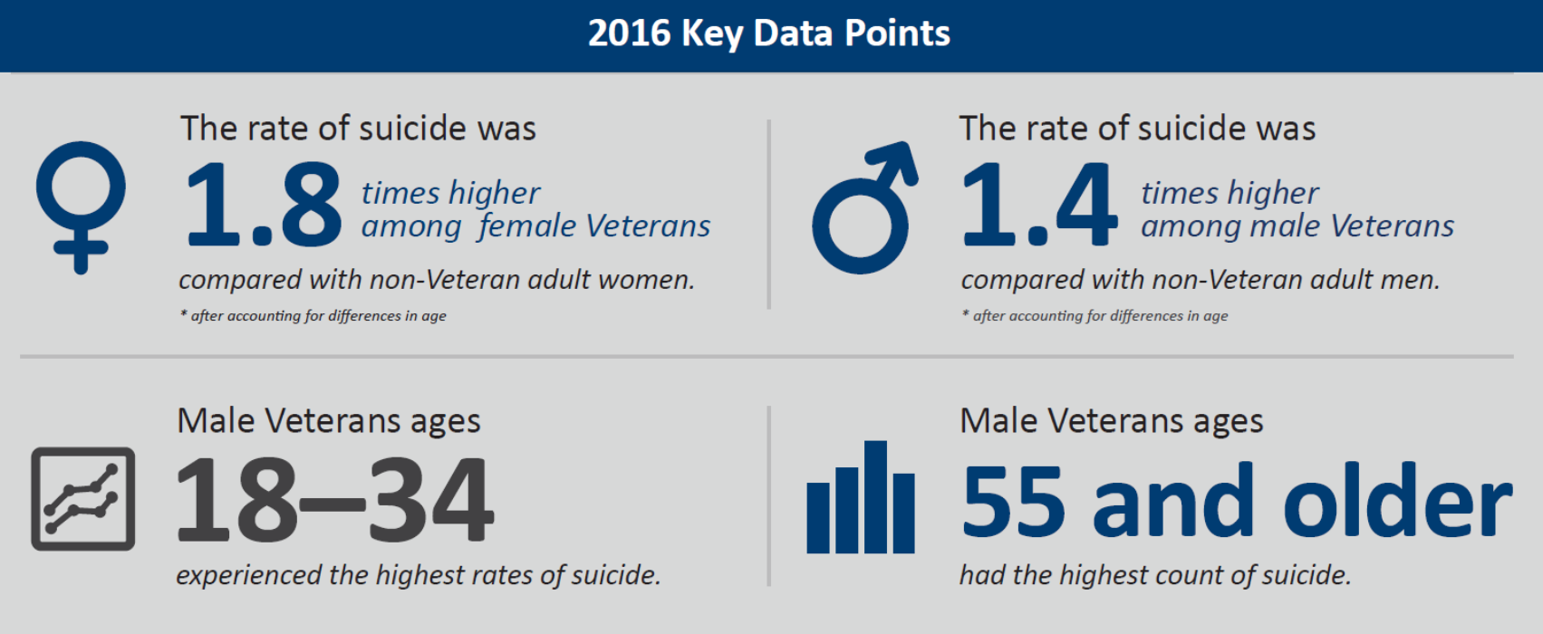
Suicide Prevention
Suicide Prevention is the VA’s top clinical priority.
  Effective outreach, access to services, and Veteran-centered care are all key to this effort.
Engagement in VHA care:
  63% of Vets who died by suicide in 2016 were not in VHA care.
Notes:
In 2015, an average of 20.6 active-duty Service members, non-activated Guard or Reserve members, and other Veterans died by suicide each day. 6.1 of these were Veterans who had recently used VHA services.
Veteran suicide rate decreased slightly from 2015 to 2016
30.5 (2015) to 30.1 (2016) per 100,000 Veterans
Increase from 2005, but…
Rate of increase was slower for Veterans in VHA care (13.7% vs. 26%)
Overall rate was higher for those with VHA care (receiving services for conditions that increase risk)

Slide 7
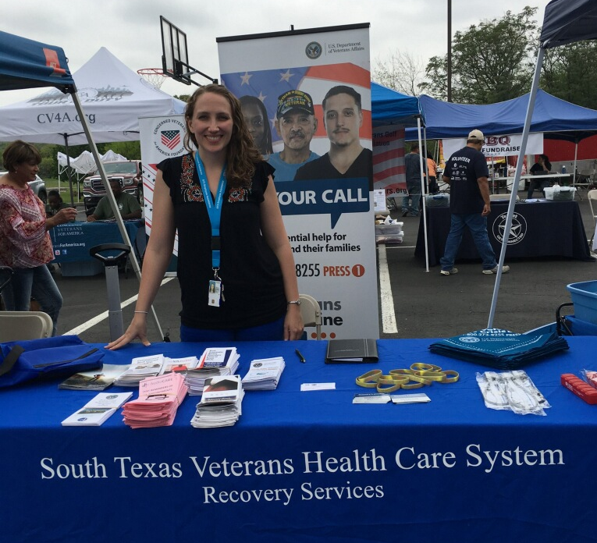
Outreach & Navigation of Services
Activities of the VHMACST are up to the Council, but…
  There will be opportunities for the VHMACST to assist VA staff with outreach to Veterans and families:
    Advise VA providers on outreach strategies
    & co-develop materials
    Attend outreach events
    Help engage other Veterans in
    need of VA services

Slide 8
How do I become involved?
Starts with your attendance today
Complete and submit an application
Come to meetings, participate, and share your ideas and talent
Be consistent and dependable
Have FUN
Attend Outreach Events (optional)
Notes:
A

Slide 9
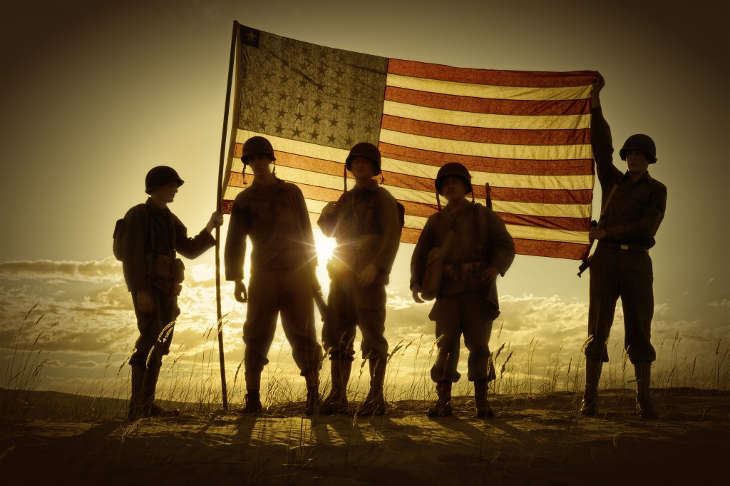
Questions?
Helping Veteran’s,
Help Themselves
Notes:
A & B

Slide 10
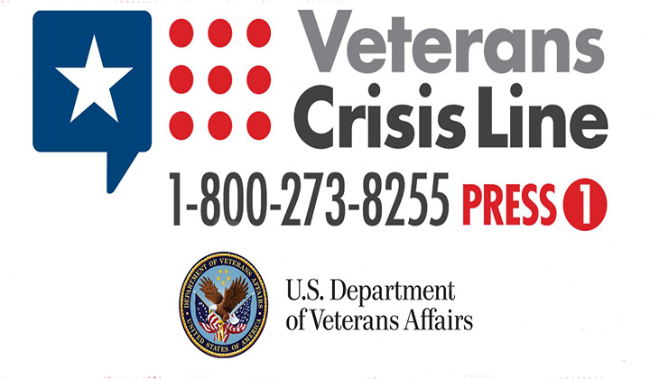
Questions?
Dr. David A. La Pointe VHMACST (Chair)
210-488-1593 (Cell)
210-236-9667 (Home)
Davelp.lapointe@gmail.com
VHMACST@gmail.com
Gingerlei Seda VHMACST (Co-Chair)
210-790-7901
leiginsed@gmail.com
VHMACST@gmail.com
Kesha R. Delasbour VHMACST (Secretary)
832-493-4137
Kesha_03@Hotmail.com
VHMACST@gmail.com

Slide 11
Questions?
Betsy.Davis@va.gov
(210) 949-3151
Monday-Friday 8am-4:30pm
Austin.Lawler@va.gov
(210) 617-5300 ext 17066
Monday-Friday 7:30am-4:00pm

